Slide 1
Logistics: Project
Project presentation
Dec 7/9 during lectures
Everyone is expected to attend both lectures
10 minutes for presentation + 1~2 minutes for QA and transition
A good practice to leverage what you learned (through giving presentations and observing others) to prepare for this final presentation

Slide 2
Logistics: Project
Project reports
Due: Dec 12 (no late submissions)
Up to 6 pages (plus additional pages for only references/citations)
No strict format requirements
You are encouraged to use standard templates, such as AAAI format or NeurIPS format
For research projects
Your report should be structured in a way similar to the research papers we have read throughout the semester. (e.g., include introduction, related work, research problem or formulation, your proposed approach, results, conclusions).
For literature surveys
Do not summarize papers one by one. Find a theme, categorize papers, and put them in context.
Example: Making Better Use of the Crowd: How Crowdsourcing Can Advance Machine Learning Research. Vaughan. JMLR 2018.

Slide 3
Lecture 21 Strategic Classification
Instructor: Chien-Ju (CJ) Ho

Slide 4
Classification
Standard setup of (supervised) machine learning
Finding patterns from the given training datasets
Use the pattern to make predictions on new testing data
Fundamental assumption:
Training and testing data points are i.i.d. drawn from the same distribution

Slide 5
Example: Spam Filter

Slide 6
Example: Spam Filter

Slide 7
Example: Spam Filter

Slide 8
Social Program Eligibility [Camacho and Conover, 2012]

Slide 9
Goodhart’s law:
“If a measure becomes the public’s goal, it is no longer a good measure.”

Slide 10
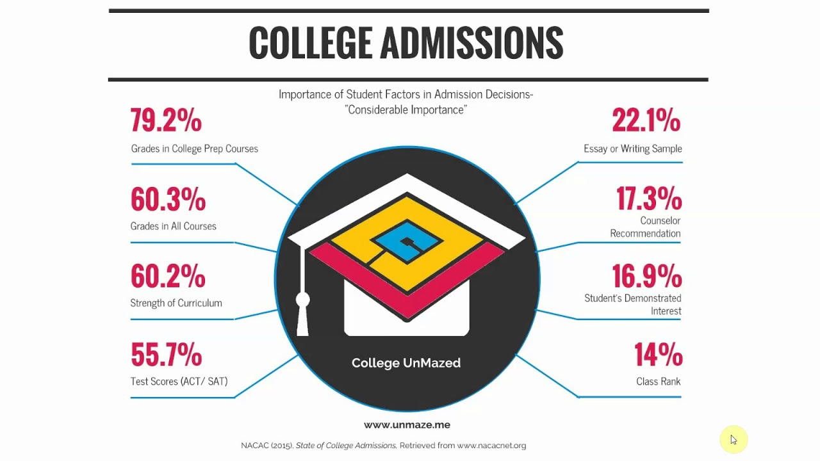
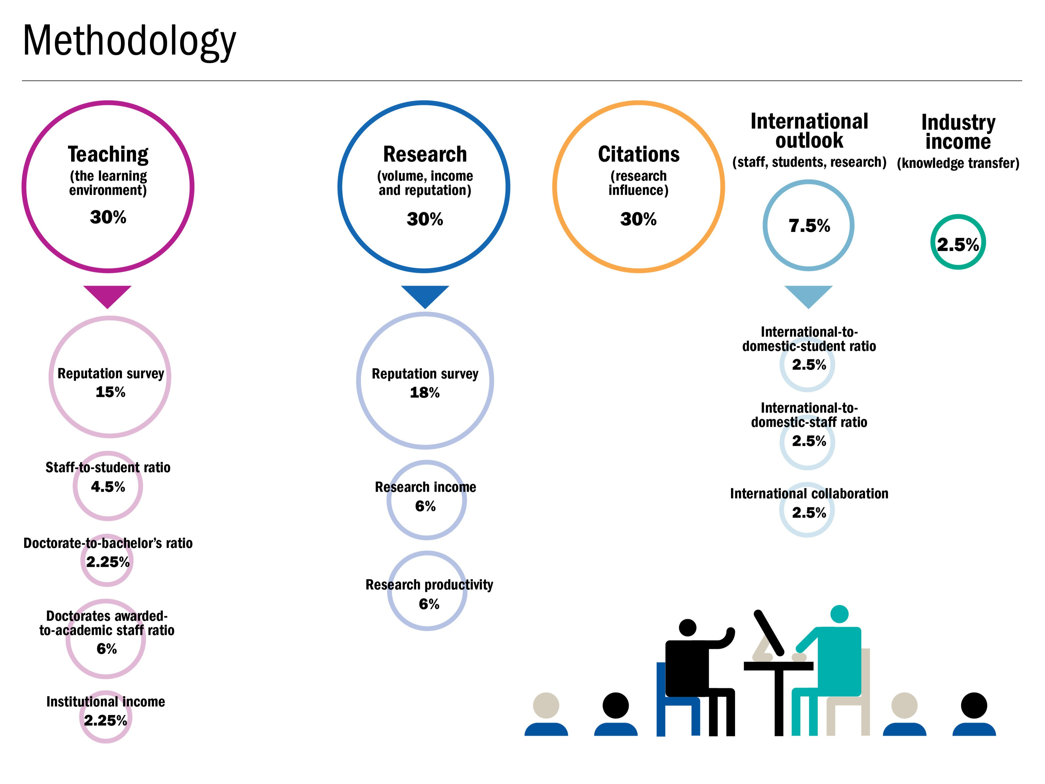

Slide 11
Strategic Classification

Slide 12
Warm-Up Discussion
What are other examples of strategic classifications in the real world? What are the potential consequences of not considering the issues of strategic manipulations?
On a high-level, what do you think can be done to help mitigate or address the issues of strategic manipulations?
As an example, Google keep secret of their ranking algorithms in the search results. Then companies that focus on SEO (search engine optimization) try to find out how the algorithms works. Is secrecy a good approach? What other options do we have?

Slide 13
Strategic Classification

Slide 14
How to take this interaction between ML algorithms and data-holders into account?
Game theoretical modeling

Slide 15
Game Theoretical Modeling
Key elements:
Players, actions, payoffs
Players: Jury (e.g., university) and Contestants (student applicants)
Actions:
First, Jury decides on the machine learning model (binary classification)
Then, Contestant decides how to alter their features based on the model
Payoffs
Jury wants to maximize the probability of correct predictions
Contestants want to be selected (being predicted as 1)

Slide 16


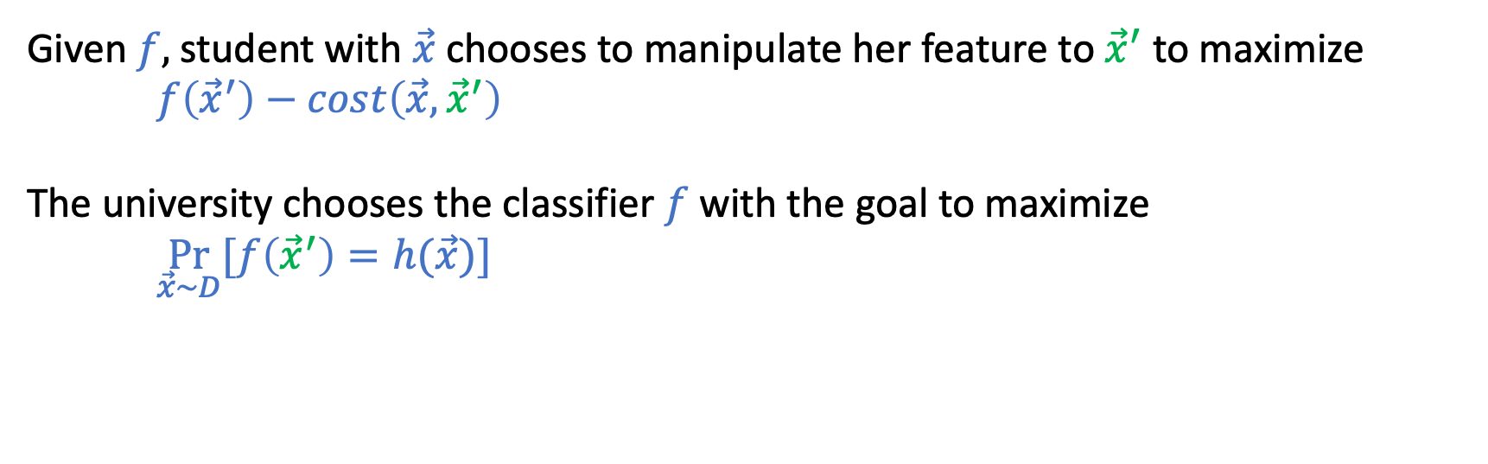
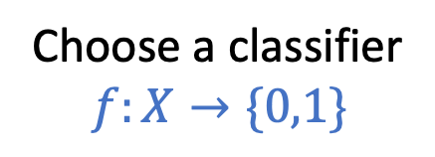
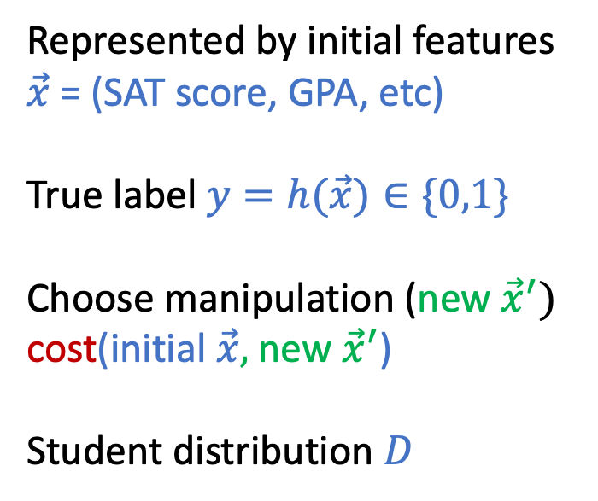
Represented by initial features $\vec{x}$ = (SAT score, GPA, etc)
True label $y=h(\vec{x})∈\{0,1\}$
Choose manipulation (new ${\vec{x}}^{′})$
cost(initial $\vec{x},$new ${\vec{x}}^{′}$)
Student distribution $D$
Choose a classifier
$$f:X→\{0,1\}$$
Given $f,$student with $\vec{x}$chooses to manipulate her feature to ${\vec{x}}^{′}$ to maximize
$f\left({\vec{x}}^{′}\right)−cost\left(\vec{x},{\vec{x}}^{′}\right)$
The university chooses the classifier $f$ with the goal to maximize
$\underset{\vec{x}\sim D}{Pr}{[f\left({\vec{x}}^{′}\right)=h(\vec{x})]}$
Stackelberg Game
Similar to the “contract design” problem
The “classifier” is a contract

Slide 17

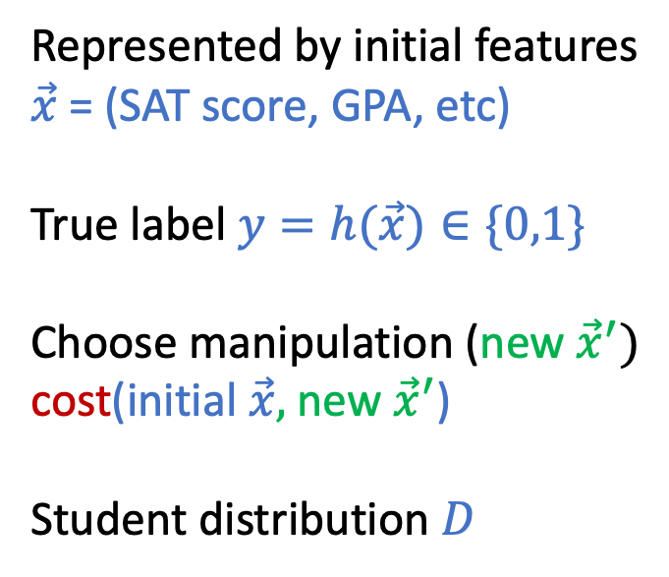
Represented by initial features $\vec{x}$ = (SAT score, GPA, etc)
True label $y=h(\vec{x})∈\{0,1\}$
Choose manipulation (new ${\vec{x}}^{′})$
cost(initial $\vec{x},$new ${\vec{x}}^{′}$)
Student distribution $D$
Choose a classifier
$$f:X→\{0,1\}$$
Research question of the required reading:
Design the algorithm for computing the optimal $f$ when taking strategic manipulations into account.

Slide 18

Main Results
In general cases, finding the classification rule with near-optimal performance is NP-hard.
In special cases, there exist efficient algorithms
E.g., when cost($\vec{x},{\vec{x}}^{′}$) $=\vec{α}⋅({\vec{x}}^{′}−\vec{x})$

Slide 19
More Aspects of Strategic Classification
1. Evaluation vs. Incentive
2. Social costs

Slide 20

Types of Manipulations
Say that your insurance company wants you to stay healthy (so they can pay less) and decide to reward you if you hit the step target on your phone.

Slide 21
Gaming vs. Improvement
Gaming
Alter the decision by manipulating proxy features without changing the underlying label
Unjustifiable or pointless effort
Considered in the required reading
Improvement
Change the decision by manipulation that changes the underlying label
Maybe this is the positive effect that we want to utilize

Slide 22
The Purposes of Decision Rules
To evaluate the candidates
Assume there is a true unobservable quality that we care about
e.g., whether the student will succeed or not
Unobservable quality leads to observable but manipulatable features
Aims to classify based on the true quality with gaming behavior
To incentivize the candidates
Assume the true unobservable quality can be improved
Incentivize candidates to perform desired improvements

Slide 23
Discussion
Think about examples that we can use classification as incentive to motivate desired actions.
How can we design the incentives?
Informally, what behavior do you want to encourage, and how to make the classification rule achieve that?
Formally, how the classification rule should look like? How to find the “optimal” rule?
Example: how the course grades are split up would impact what you do for the course. What’s the “best” way to design the grades? (What should be the desired behavior?)

Slide 24
How do classifiers induce agents to invest effort strategically?
Kleinberg and Raghavan. EC 2019.

Slide 25



Slide 26
“Test preparation has been the focus of intense argument for many years, and all sorts of different terms have been used to describe both good and bad forms. . . I think it’s best to. . . distinguish between seven different types of test preparation: Working more effectively; Teaching more; Working harder; Reallocation; Alignment; Coaching; Cheating. The first three are what proponents of high-stakes testing want to see”
- Daniel Koretz, Measuring Up.

Slide 27
How to induce the desired behavior?

Slide 28
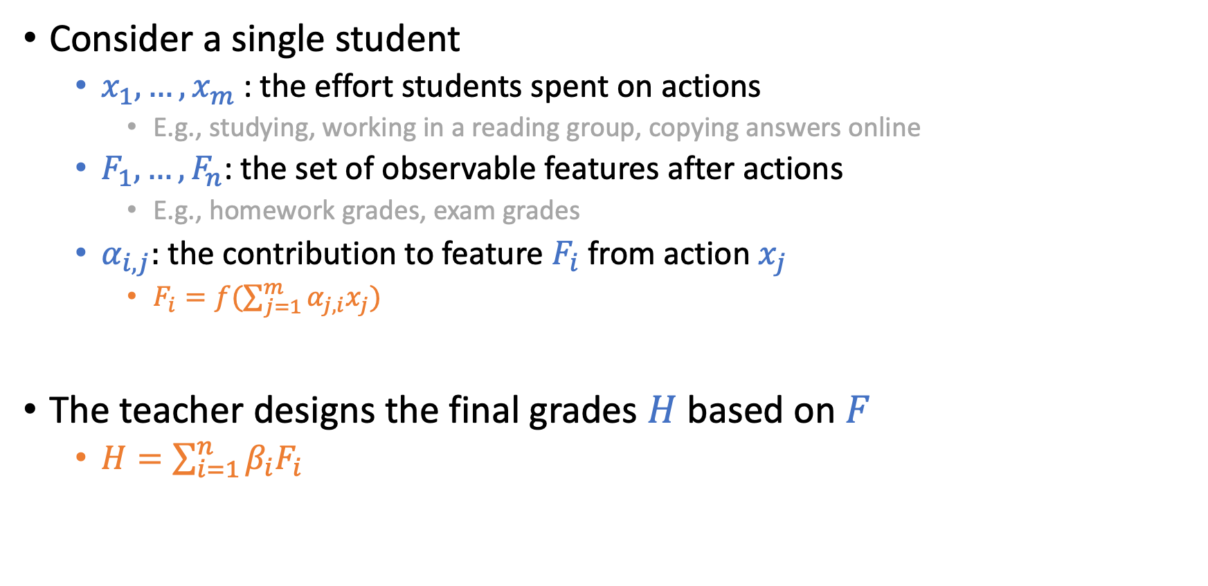
Graphical Representation of the Model
Consider a single student
$x_{1},…,x_{m}$ : the effort students spent on actions
E.g., studying, working in a reading group, copying answers online
$F_{1},…,F_{n}$: the set of observable features after actions
E.g., homework grades, exam grades
$α_{i,j}:$ the contribution to feature $F_{i}$ from action $x_{j}$
$F_{i}=f(\sum_{j=1}^{m}{α_{j,i}x_{j}})$
The teacher designs the final grades $H$ based on $F$
$H=\sum_{i=1}^{n}{β_{i}F_{i}}$

Slide 29



Example: Course Grades
cheating
Test Score
studying
copying homework
Homework Score

Slide 30
Example: Course Grades
cheating
When the desired effort is substitutable,
we can’t incentivize that effort.
3
Test Score
studying
1
1
copying homework
3
Homework Score

Slide 31
Example: Course Grades
cheating
When the effort is not substitutable,
there is a linear mechanism incentivizing that effort.
Test Score
studying
copying homework
Homework Score
Finding that mechanism is NP-hard.

Slide 32
The Purposes of Decision Rules
To evaluate the candidates
Assume there is a true unobservable quality that we care about
Whether the student will succeed or not
Unobservable quality leads to observable but manipulatable features
Aims to classify based on the true quality with gaming behavior
To incentivize the candidates
Assume the true unobservable quality can be improved
Incentivize candidates to perform desired improvements

Slide 33
More Aspects of Strategic Classification
1. Evaluation vs. Incentive
2. Social costs

Slide 34

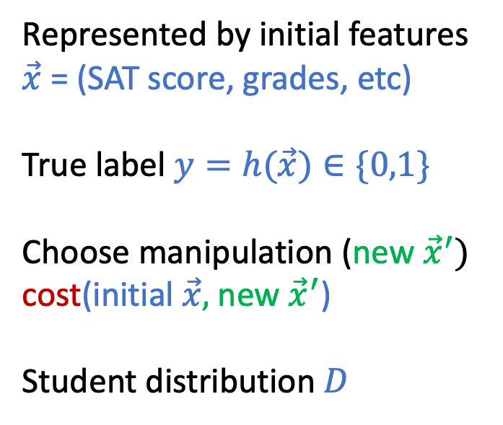
There Are Two Parties in Strategic Classification
Represented by initial features $\vec{x}$ = (SAT score, grades, etc)
True label $y=h(\vec{x})∈\{0,1\}$
Choose manipulation (new ${\vec{x}}^{′})$
cost(initial $\vec{x},$new ${\vec{x}}^{′}$)
Student distribution $D$
Choose a classifier
$$f:X→\{0,1\}$$
Is it reasonable to only optimize the benefit of the institution?

Slide 38
Institution Utility vs. Social Burden [Milli et al. 2018]
Institution utility: the utility for deploying the decision rule
Social burden: the amount of effort contestants need to put in

Slide 40
Discussion
People in advantage groups might be able to pay smaller costs to manipulate the features. What are the example applications that this could happen (e.g., SAT scores)?
What do you think are the bad consequences with this imbalanced manipulations? What are potential ways we can deal with them?

Slide 41
The Disparate Effects of Strategic Manipulation
Hu, Immorlica, and Vaughan. FAT* 19.

Slide 42

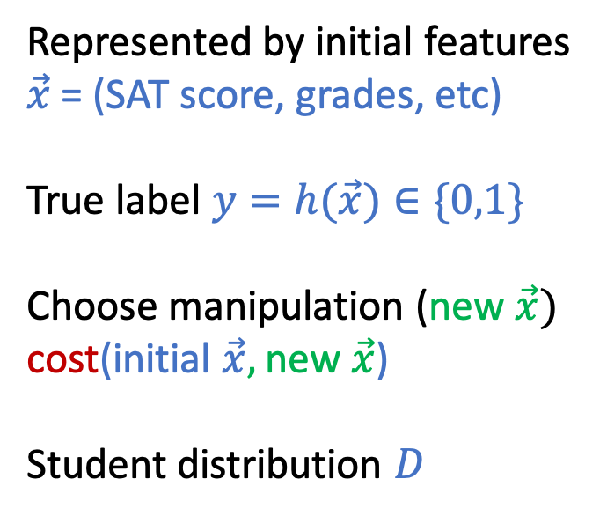
Represented by initial features $\vec{x}$ = (SAT score, grades, etc)
True label $y=h(\vec{x})∈\{0,1\}$
Choose manipulation (new $\vec{x})$
cost(initial $\vec{x},$new $\vec{x}$)
Student distribution $D$
Choose a classifier
$$f:X→\{0,1\}$$

Slide 43
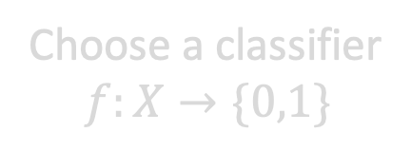
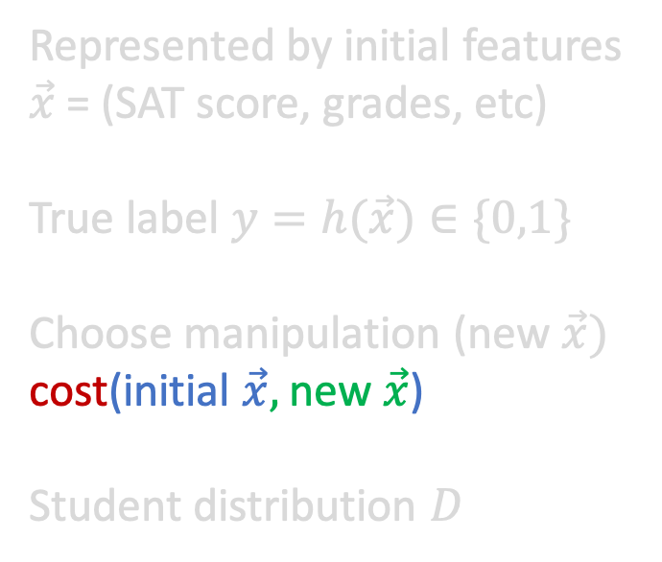
Represented by initial features $\vec{x}$ = (SAT score, grades, etc)
True label $y=h(\vec{x})∈\{0,1\}$
Choose manipulation (new $\vec{x})$
cost(initial $\vec{x},$new $\vec{x}$)
Student distribution $D$
Choose a classifier
$$f:X→\{0,1\}$$
What if this cost is different across groups?

Slide 44
Main Results
Group differences
Group A: Advantage group
Group B: Disadvantage group
Result 1: Reinforcing inequalities
Under mild conditions, the equilibrium classifier more likely to mistakenly exclude people from group B and mistakenly admit people from group A
Result 2: Subsidy interventions?
There exists cases that both groups are worse-off when a subsidy is offered compared to no subsidy at all.

Slide 45
Summary: Strategic Classification
Mitigate the effect of gaming
How do we ensure we still have a good classifier even if we know that people will game the system
Using classification to incentivize improvements
Classification as incentives
Social costs
The tradeoffs between the ML utility and the costs incurred on the individuals

Slide 46
Discussion

